Slide 1
Weather Trends Analysis
Group2: Guruksha Gurnani, Meng-Fei Hung
DATS 6450: Cloud Computing
March 18th, 2024

Slide 2
Table of Contents
Project Introduction/Definition
Background
Data Source
Implemented Features
Expected Outcomes
Project Architecture
Logical Architecture
Data Flow
Project Implementation
AWS Lambda Demonstration
Quicksight Demonstration

Slide 3
Project Introduction

Slide 4

Background
Global warming will have a long-term and significant impact on the Earth. From 1901 to 2020, temperatures increased by about 1.98°F (1.1°C).
Leveraging AWS to analyze and visualize weather trends in the major cities in the United States over a decade.

Slide 5
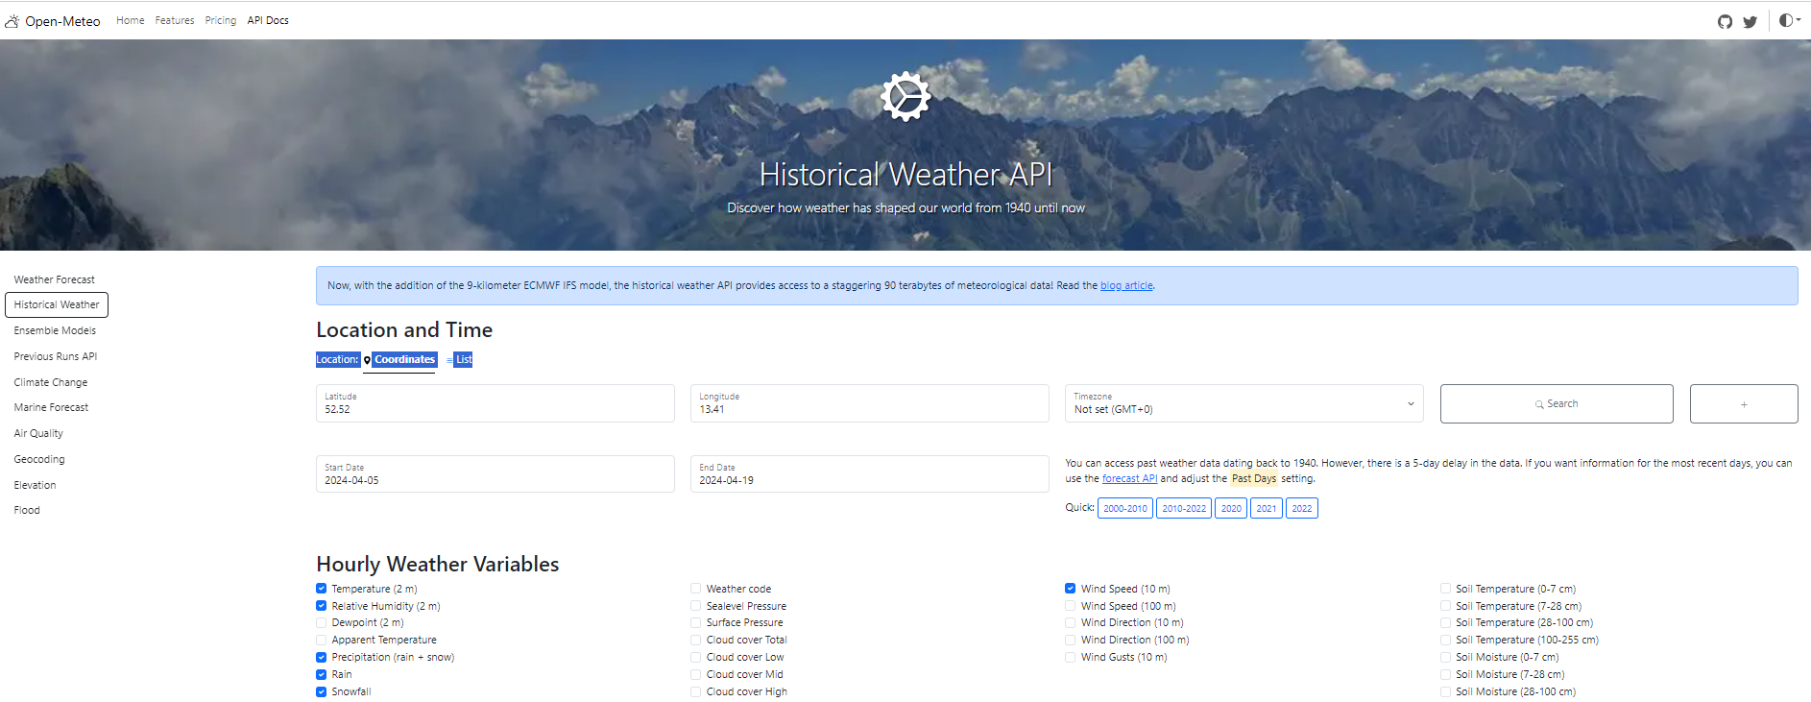
Data Source
Data source: Open-Meteo Historical Weather dataset
https://open-meteo.com/en/docs/historical-weather-api#start_date=2014-01-01&end_date=2023-12-31&hourly=temperature_2m,relative_humidity_2m,precipitation,rain,snowfall,wind_speed_10m,sunshine_duration
3652 daily data
10 years: 2014/01~2023/12

Slide 6
Data Source (Cont’d)
Major cities on the East Coast, West Coast, South and Central United States:
East coast: District of Columbia, New York City, Boston
West coast: Seattle, San Francisco, Los Angeles
North: Chicago
South: Houston, Miami
Central: Denver, Phoenix
Data features:
Temperature
Rain
Snow
Wind
Sunshine duration
radiation
1
2
3
4
5
6

Slide 7
Implemented Features
AWS S3: For secure and scalable storage of the raw and processed weather data.
AWS Lambda: Utilized for data processing tasks such as initial data cleaning, transformation, and regular data updates.
Visualization: Leveraging Amazon Quick Sight to create interactive dashboards and visualizations, offering insights into weather trends across different regions and time frames.

Slide 8
Expected Outcomes
Implement effective practical applications utilizing AWS S3, Lambda for data processing, and QuickSight for visualization.
Understand the weather monthly trends, seasonal trends, and annual trends in the major cities in the east, west, north, south, and central of the United States.
Get insight from the trends of these historical datasets which can be used to help predict the weather in the future.

Slide 9
Project Architecture

Slide 10







Logical Architecture Architecture
Creat Policies: Modify permissions in s3-lambda-weather
AWS Identity and Access Management (IAM)
Role
Write the code to make an HTTP request to the external API using libraries
Upload codes and packages to Lambda
Storage data to S3
Data Source API
AWS Lambda
Amazon Simple Storage Service (Amazon S3)
Amazon QuickSight

Slide 11

Data Flow
01
02
03
04
05
AWS Lambda
Amazon S3
Amazon QuickSight
Amazon S3
Data source API
Create AWS Lambda function and write codes to access the data from API
Storage the previous data in S3 bucket
Creates charts using this data by Amazon QuickSight
Storage graphics in S3 bucket

Slide 12
Project Implementation

Slide 13
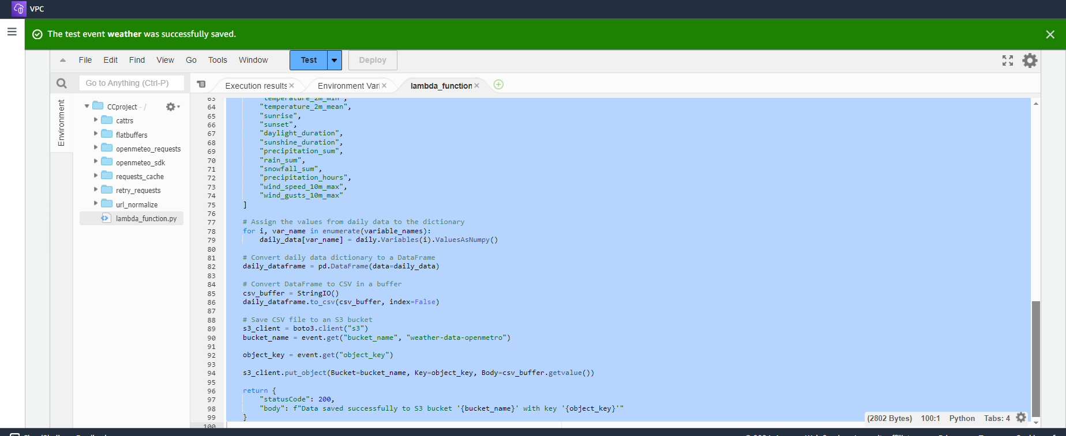
AWS Lambda Demonstration
AWS Lambda is a serverless compute service for running code without having to provision or manage servers. all you need to do is supply your code in one of the language runtimes that Lambda supports

Slide 14
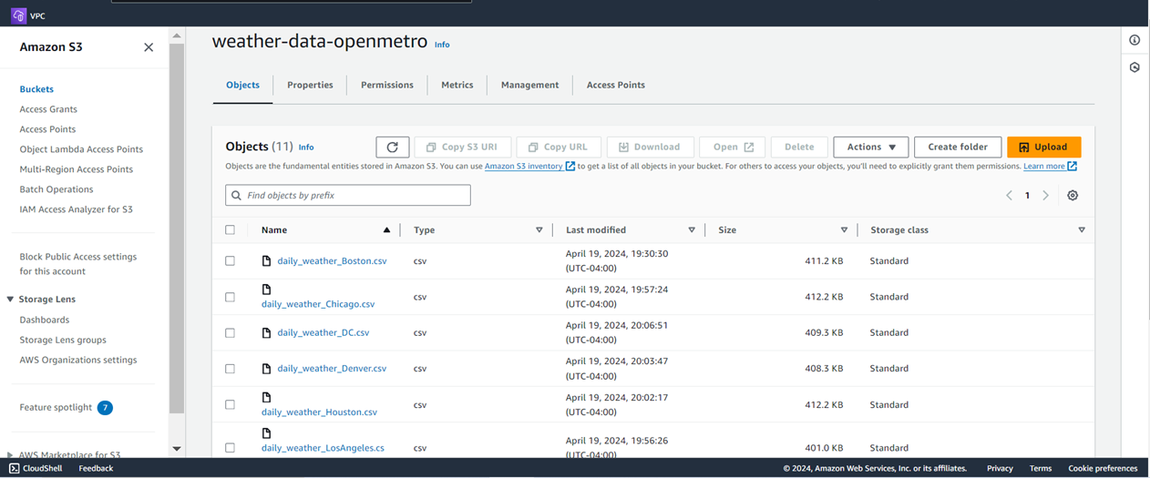
AWS Lambda Demonstration
Weather data of 11 cities is storage in S3

Slide 15
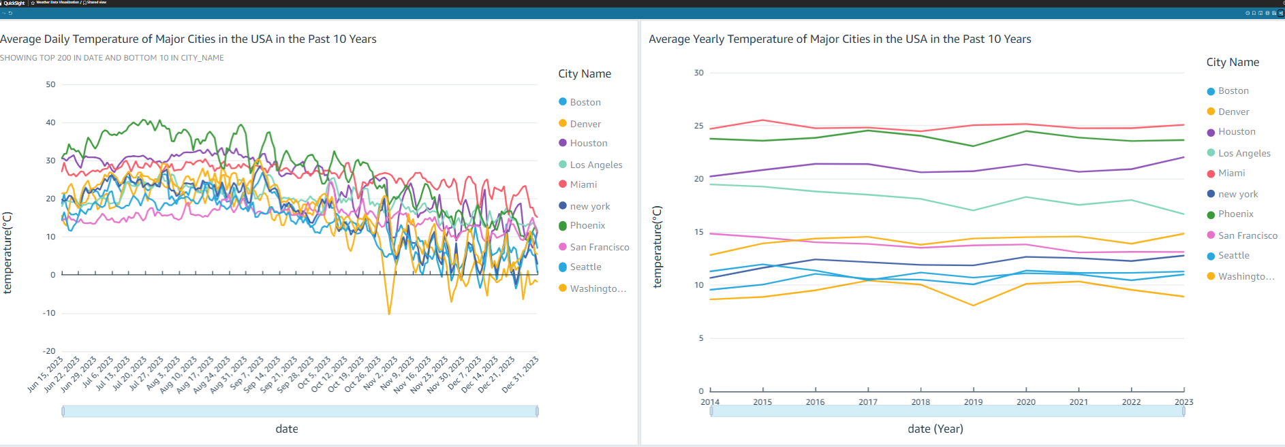
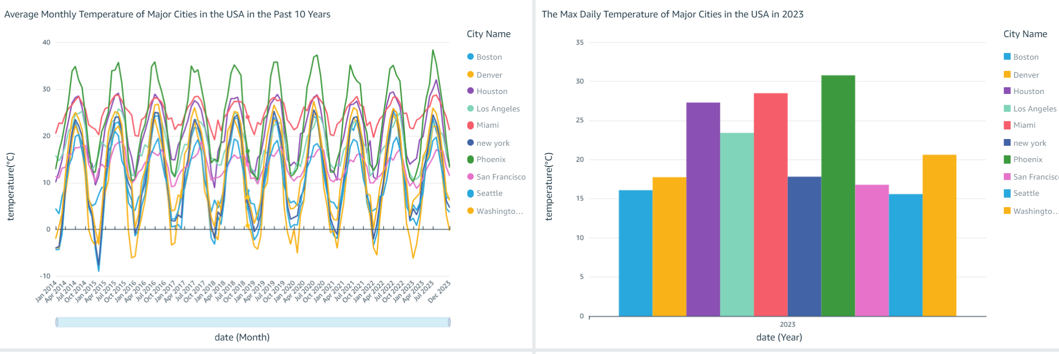
Quicksight Demonstration

Slide 16
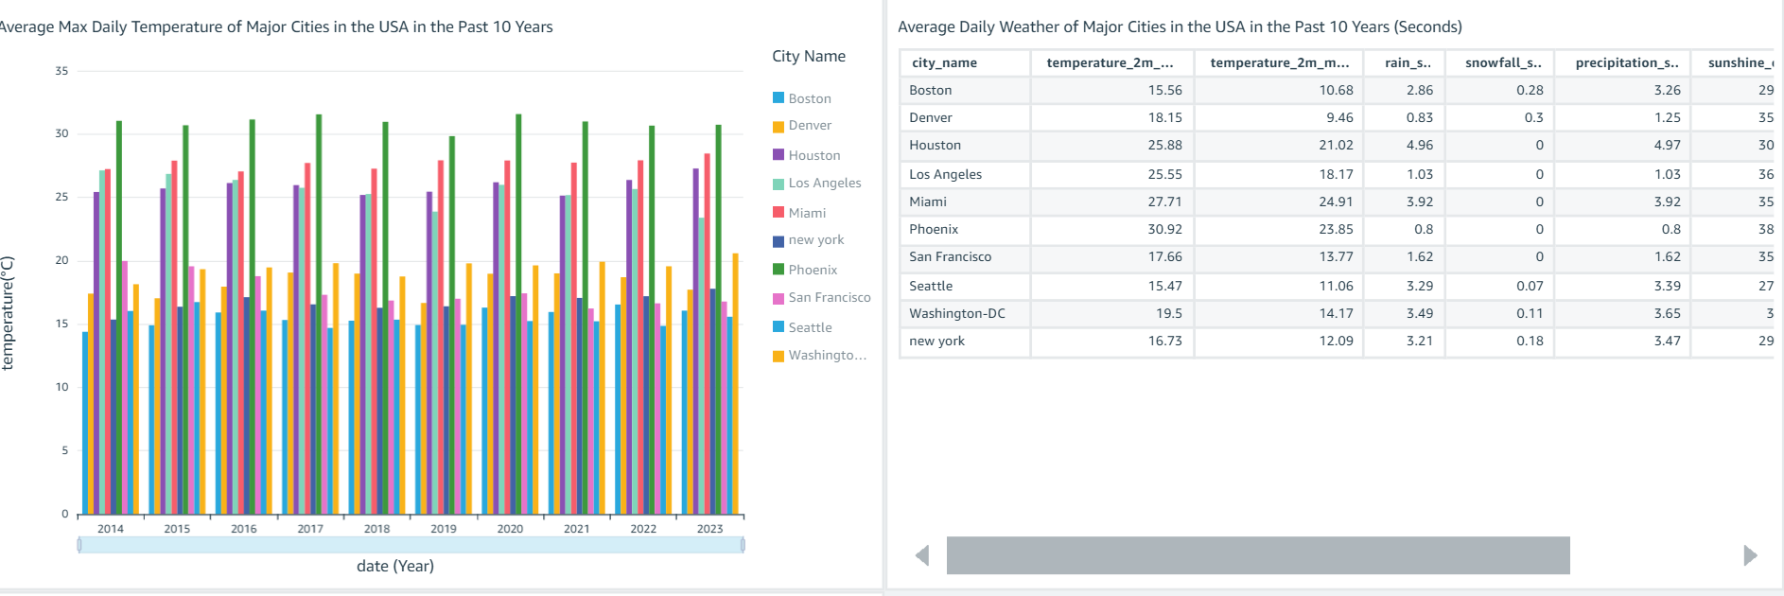
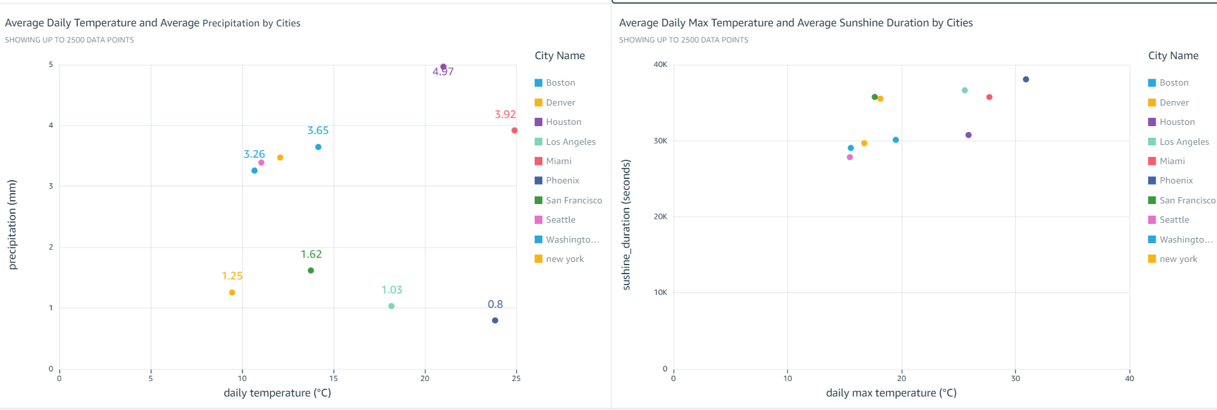
Quicksight Demonstration

Slide 17
Update Git link
Demonstration link:
https://us-east-1.quicksight.aws.amazon.com/sn/dashboards/41c332b1-ea96-4790-94a3-b41f24e02b71/views/d1b7dec3-af89-418c-929c-95f4d619114f?directory_alias=cloudcomputing
GitHub link:
https://github.com/m-mcdougall/Sagemaker_Tumor_Classifier_DATS6450

Slide 18
Thank You for Your Listening

